Slide 1

IP ADDRESS CLASSES

Slide 2
IP network address
Network layer addresses are 32 bits long.
The are presented as four octets in dotted decimal format.
The IP address has two components: Network ID and Host ID.

Slide 3
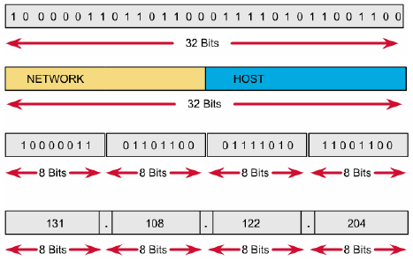
IP address format

Slide 4
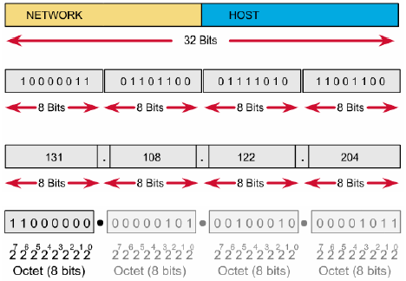
Binary and decimal conversion

Slide 5
Why we need to know B-D conversion
Use of calculators is discouraged for two reasons :
  First, practitioners of networking often need to make quick.
  Second, no calculators are allowed on the CCNA exam.

Slide 6
Network ID and host ID
Network ID:
  Assigned by Internet Network Information Center.
  Assigned by upper organization.
  Identifies the network to which a devices is attached.
Host ID:
  Assigned by a network administrator.
  Identifies the specific device on that network.

Slide 7
Bits on the IP address
Network Bits:
  Identifies network ID
  Identifies class of the IP address
  All of bits are 0: not allowed
Host Bits:
  Identifies host ID
  All of bits are 0: reserved for network address
  All of bits are 1: reserved for broadcast address

Slide 8
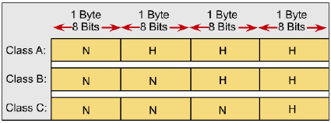
IP address classes
Different class addresses reserve different amounts of bits for the Network and Host portions of the address
Provide the flexibility required to support different size networks

Slide 9
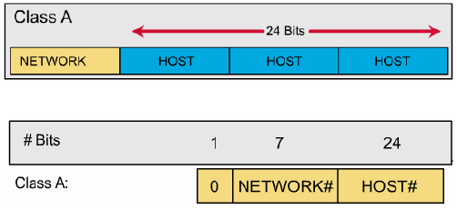
IP address classes: Class A

Slide 10
IP address classes: Class A
The first bit of a Class A address is always 0.
The first 8 bits to identify the network part of the address.
Possible network address from 1.0.0.0 to 127.0.0.0.
The remaining three octets can be used for the host portion of the address.
Each class A network have up to 16,777,214 possible IP addresses.

Slide 11
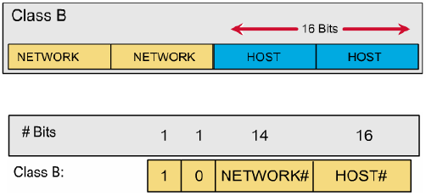
IP address classes: Class B

Slide 12
IP address classes: Class B
The first 2 bits of a Class B address is always 10.
The first two octets to identify the network part of the address.
Possible network address from 128.0.0.0 to 191.255.0.0.
The remaining two octets can be used for the host portion of the address.
Class B network have up to 65.534 possible IP addresses.

Slide 13
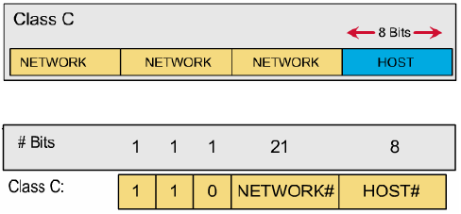
IP address classes: Class C

Slide 14
IP address classes: Class C
The first 3 bits of a Class C address is always 110.
The first three octets to identify the network part of the address.
Possible network address from 192.0.0.0 to 223.255.255.0.
The remaining last octet can be used for the host portion of the address.
Class C network have up to 254 possible IP addresses.

Slide 15
IP address classes: Summary
1.0.0.0 - 126.0.0.0 : Class A.
127.0.0.0 : Loopback network.
128.0.0.0 - 191.255.0.0 : Class B.
192.0.0.0 - 223.255.255.0 : Class C.
224.0.0.0 < 240.0.0.0 : Class D, multicast.
>= 240.0.0.0 : Class E, reserved.

Slide 16
Network address
Network address provide a convenient way to refer to all of the addresses on a particular network or subnetwork.
Two hosts with differing network address require a device, typically a router, in order to communicate.
An IP address that ends with binary 0s in all host bits is reserved for the network address.

Slide 17
Broadcast address
Broadcast goes to every host with a particular network ID number.
An IP address that ends with binary 1s in all host bits is reserved for the directed broadcast address.
An IP address with binary 1s in all network bits and host bits is reserved for the local broadcast address.

Slide 18
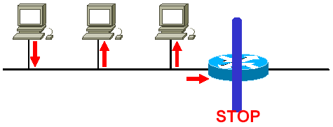
Local broadcast address
Broadcast address
255.255.255.255

Slide 19
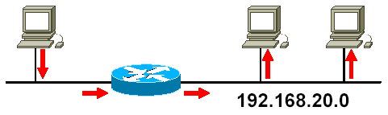
Directed broadcast address
Broadcast address
192.168.20.255

Slide 20
Example: 172.16.20.200
172.16.20.200 is Class B address
Network portion: 172.16
Host portion: 20.200
Network address: 172.16.0.0
Broadcast address: 172.16.255.255

Slide 21
Private addresses
According to RFC-1918.
Organizations make use of the private Internet address space for hosts that require IP connectivity within their enterprise network, but do not require external connections to the global Internet.
Class A: 10.0.0.0
Class B: 172.16.0.0 - 172.31.0.0
Class C: 192.168.0.0 - 192.168.255.0

Slide 22
Preparation for LAB
Lab companion:
– 10.4.1: IP address classes.

Slide 23
Lab 10.4.1: Step 1
Review IP address classes and their characteristics.

Slide 24
Lab 10.4.1: Step 2
What is the decimal and binary range of the first octet of class B IP addresses?
– Decimal: 128 – 191
– Binary: 10000000 – 10111111
Which octet(s) represent the network portion of a class C IP address?
– The first three octets
Which octet(s) represent the host portion of a class A IP address?
– The last three octets

Slide 25
Lab 10.4.1: Step 3
Host IP Address | Address Class | Network Address | Host Address | Broadcast Address
218.14.55.137 | C | 218.14.55 | 137 | 218.14.55.255
123.1.1.15 | A | 123 | 1.1.15 | 123.255.255.255
150.127.221.244 | B | 150.127 | 221.244 | 150.127.255.255
194.125.35.199 | C | 194.125.35 | 199 | 194.125.35.255
175.12.239.244 | B | 175.12 | 239.244 | 175.12.255.255

Slide 26
Lab 10.4.1: Step 4 – Valid address
150.100.255.255
175.100.255.18
195.234.253.0
100.0.0.23
188.258.221.176
127.34.25.189
224.156.217.73

Slide 27
SUBNETTING
AND
CREATING A SUBNET

Slide 28
Why we need to divide network?
Network administrators sometimes need to divide networks, especially large ones, into smaller networks:
  Reduce the size of a broadcast domain.
  Improve network security.
  Implement the hierarchical managements.
So we need more network addresses for your network. But I want the outside networks see our network as a single network.

Slide 29
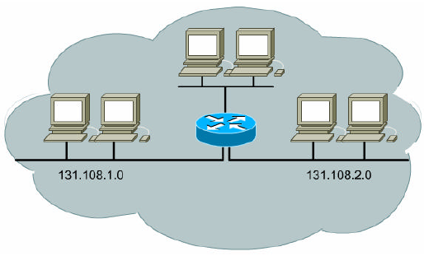
Divide network by three

Slide 30
Subnetting
Subnetworks are smaller divisions of network.
Subnet addresses include the Class A, Class B, or Class C network portion, plus a subnet field and a host field.
To create a subnet address, a network administrator borrows bits from the original host portion and designates them as the subnet field.
Subnet addresses are assigned locally, usually by a network administrator.

Slide 31
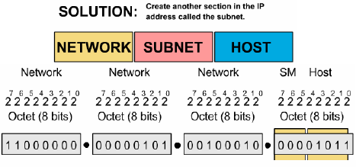
Subnetting
HOW???
By using a SUBNET MASK

Slide 32
Subnet mask
“Extended Network Prefix”.
Determines which part of an IP address is the network field and which part is the host field.
32 bits long.
Divided into four octets.
Network and Subnet portions all 1’s.
Host portions all 0’s.

Slide 33
Default subnet mask: Example
192.168.2.100 / 255.255.255.0
11000000.10101000.00000010.01100100
11111111.11111111.11111111.00000000
11000000.10101000.00000010.00000000
Class C network:
  24 bits for network portion.
  0 bits for subnet portion.
  8 bits for host portion.
Subnet address: 192.168.2.0

Slide 34
Subnet mask: Example
172.16.65.100 / 255.255.240.0
10101100.00010000.01000001.01100100
11111111.11111111.11110000.00000000
10101100.00010000.01000000.00000000
Class B network:
  16 bits for network portion.
  4 bits for subnet portion.
  12 bits for host portion.
Subnet address: 172.16.64.0

Slide 35
How many bits can I borrow?
All of subnet bits are:
  0 : reserved for network address.
  1 : reserved for broadcast address.
The minimum bits you can borrow is: 2 bits.
The maximum bits you can borrow is:
  A: 22 bits ~ 222 - 2 = 4.194.302 subnets.
  B: 14 bits ~ 214 - 2 = 16.382 subnets.
  C: 06 bits ~ 206 - 2 = 62 subnets.

Slide 36
Boolean algebra review
Boolean operators:
  AND
  OR
  NOT

Slide 37
AND operator
1 AND 1 = 1
1 AND 0 = 0
0 AND 1 = 0
0 AND 0 = 0

Slide 38
OR operator
1 OR 1 = 1
1 OR 0 = 1
0 OR 1 = 1
0 OR 0 = 0

Slide 39
NOT operator
NOT 1 = 0
NOT 0 = 1

Slide 40
Boolean algebra examples
1010 AND 0110 = 0010
1010 OR 0110 = 1110

Slide 41
Why we need to know Boolean ops?
IP Address | AND | Subnet Mask | = | Network and Subnet address
Network layer performs the Boolean operations in order to find the network ID of a subnet
Example:
  172.16.65.100 AND 255.255.240.0
  Network address: 172.16.64.0

Slide 42
Subnetting example
Given network 172.16.0.0.
We need 8 usable subnets and up to 1000 hosts on each subnet.

Slide 43
Calculating a subnet
Determine the class of network and default subnet mask.
Determine how many bits to borrow. Determine the subnet mask and the actual number of subnets and hosts.
Determine the ranges of host address for each subnet. Choose the subnets that you want to use.

Slide 44
Calculating a subnet: STEP 1
Determine the Class of network
  Class B
Determine the default subnet mask
  255.255.0.0

Slide 45
Calculating a subnet: STEP 2
Number of subnets <= 2^{n} - 2 with n is number of bits that are borrowed.
Number of hosts <= 2^{m} - 2 with m is number of bits that are remained.
Determine how many bits to borrow from the host portion from requirement:
  8 subnets.
  1000 hosts on each subnet.

Slide 46
Calculating a subnet: STEP 2 (Cont.)
Choose n = 4:
  Number of possible subnets is:
2⁴ - 2 = 14
  Number of possible hosts on each subnet is:
2⁽¹⁶⁻⁴⁾ - 2 = 4094
Other choice n = 5 , n = 6 ?

Slide 47
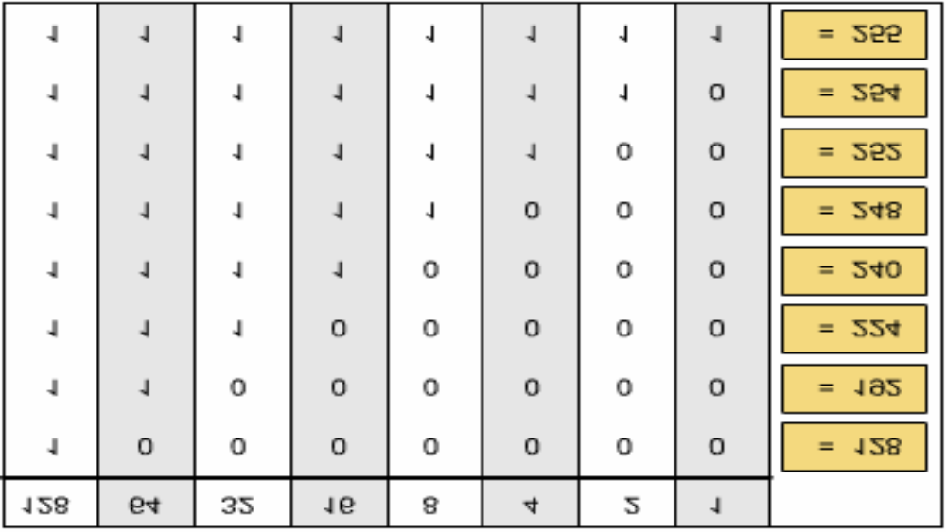
Calculating a subnet: STEP 2 (Cont.)
The subnet mask: 255.255.240.0.

Slide 48
Calculating a subnet: STEP 3
Determine the subnets and the ranges of host address for each subnet. Including:
  Sub-network addresses
  Range of usable IP addresses
  Sub-network broadcast addresses

Slide 49
Calculating a subnet: STEP 3 (Cont.)
Determine the subnets from 4 borrowed bits from the host portion (last 2 bytes):
  1st subnet: .00000000.00000000
  2nd subnet: .00010000.00000000
  3rd subnet: .00100000.00000000
  …
  15th subnet: .11110000.00000000

Slide 50
Calculating a subnet: STEP 3 (Cont.)
No | Sub-network address | Possible host address | Broadcast address | Use ?
0 | 172.16.0.0 | 172.16.0.1 – 172.16.15.254 | 172.16.15.255 | N
1 | 172.16.16.0 | 172.16.16.1 – 172.16.31.254 | 172.16.31.255 | Y
2 | 172.16.32.0 | 172.16.32.1 – 172.16.47.254 | 172.16.47.255 | Y
.. | .. | .. | .. | ..
.. | .. | .. | .. | ..
13 | 172.16.208.0 | 172.16.208.1 – 172.16.223.254 | 172.16.223.255 | Y
14 | 172.16.224.0 | 172.16.224.1 – 172.16.239.254 | 172.16.239.255 | Y
15 | 172.16.240.0 | 172.16.240.1 – 172.16.255.254 | 172.16.255.255 | N

Slide 51
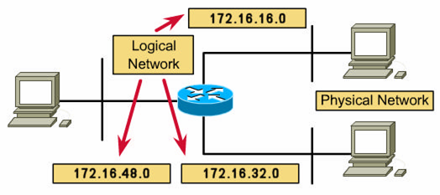
Calculating a subnet: STEP 3 (Cont.)
Using subnets No.1 to No.8.
Assign IP addresses to hosts and interfaces on each network. IP address configuration.

Slide 52
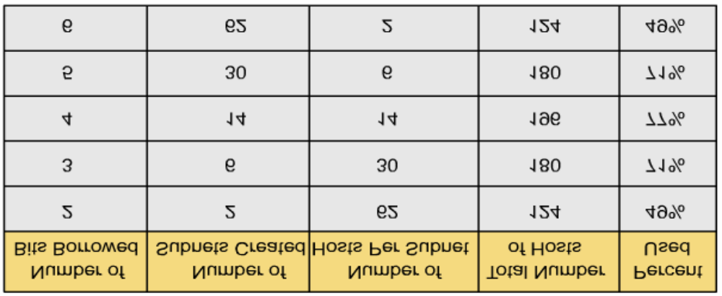
Addresses are loose by subnetting.
Network administrator must strike a balance between the number of subnets required, the hosts per subnet that is acceptable, and the resulting waste of addresses.

Slide 53
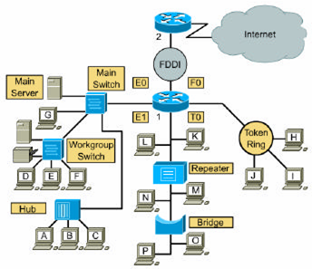
Teaching topology (10.7.6)

